Slide 1
WAC Timeline
Target Zero Update
1481 Educational Visits
Drive Route Design
Notes:
Thank you Washington Traffic Safety Education Association for inviting OSPI and DOL to your annual conference. We jumped a the opportunity to provide each of you with impact to impacts that impact your work.
Today Dan Cooke will provide an update on Target Zero data on young drivers
OSPI & DOL will do a joint presentation on the upcoming 1481 Educational Visits
DOL Audit Super visor will present on how to build a route
Lastly a quick overview of the OSPIWAC timeline. This presentation is only about the timeline and not the content of the WACs since the actual rule writing hasn’t begun

Slide 2
WAC Timeline
Notes:
Thank you Washington Traffic Safety Education Association for inviting OSPI and DOL to your annual conference. We jumped a the opportunity to provide each of you with impact to impacts that impact your work.
Today Dan Cooke will provide an update on Target Zero data on young drivers
OSPI & DOL will do a joint presentation on the upcoming 1481 Educational Visits
DOL Audit Super visor will present on how to build a route
Lastly a quick overview of the OSPIWAC timeline. This presentation is only about the timeline and not the content of the WACs since the actual rule writing hasn’t begun

Slide 3
Target Zero Update
Dan Cooke
Washington State Department of Licensing

Slide 4
Overview
Target Zero progress
Young driver fatalities and driver training
Graduated driver licensing background and best practices
Areas of Concern – opportunities for action

Slide 5
Introduction
Federal law requires each state to have a Strategic Highway Safety Plan (SHSP), which coordinates with the state’s:
Highway Safety Plan,
Commercial Vehicle Safety Plan, and
Highway Safety Improvement Plan.
Washington’s SHSP is called Target Zero. It is a practitioner’s plan, uniting contributing organizations toward a common goal of zero traffic fatalities and serious injuries on Washington roadways by 2030.

Slide 6
Target Zero – Data through 2014

Slide 7
Target Zero – Current Status

Slide 8
Goal 4: Healthy & Safe Communities
Results Washington
Outcome measure / Leading Indicator | 2016 actual level | 2016 target level needed to achieve Target Zero | On or off target?
2.4 – Decrease number of traffic fatalities on all roads from 454 in 2011 to zero (0) in 2030. | 537 (36% above target) | 394 | Off target
2.4.a –Decrease number of alcohol and/or drug impaired driver-involved fatalities from 199 in 2011 to 152 by 2017. | 277 (25% above target) | 222 | Off target
2.4.b – Decrease number of speed-involved fatalities from 169 in 2011 to 123 by 2017. | 153 (3% above target) | 149 | Off target
2.4.c – Decrease number of young drivers age 16-25 involved traffic fatalities from 146 in 2011 to 110 by 2017. | 165 (29% above target) | 128 | Off target
Notes:
Outcome measure 2.4 in Results Washington Goal 4: Healthy & Safe Communities is used to track progress toward Target Zero. The three leading indicators that fall below this outcome measure are Priority Level 1 in the Target Zero Plan, meaning they are primary factors that are involved in at least 30% of traffic fatalities between 2012 and 2014. These factors are: fatalities involving impaired drivers, speed-involved fatalities, and fatalities involving young drivers. Each of these measures exceeded their target levels for 2016. The target levels are determined by the annual reductions needed to achieve Target Zero by 2030.

Slide 9
Long-term Fatal Crash Trends
Fatal crash rates have declined over long term – but recently began to trend up in Washington

Slide 10
Impairment, young drivers, and distraction are top factors involved in traffic fatalities
Top Factors in Fatal Crashes

Slide 11
Young drivers have the highest rate of involvement in injury and fatal crashes
Crash Rates by Age Group
Driver involvements in injury and fatal crashes annually
per 10,000 licensed drivers in Washington State (based on 2012-2016 data)

Slide 12
Young Driver Fatalities: Preventable Tragedies

Slide 13
2016 Young Drivers

Slide 14
Fatal collisions involving novice drivers at 18 and 19 years old
The Benefit of Education
87.5%
94.4%
*2x Not at Fault
*Not at Fault

Slide 15
Why?
Top Three Contributing Factors for Young Driver Involved Fatal Crashes taken from Collision Reports

Slide 16
Why?
Looking at it a different way
Speeding, impairment, and distraction are all conscious choices made by the driver that can have devastating consequences when they result in a collision.
These same factors hold true for novice drivers who attend Driver Training, however the rate of involvement is cut in half.
The period of time following licensing is the most dangerous time for novice drivers. It’s not only a factor of age.
We can influence the results of potential collisions through training and experiential learning focused on hazard perception, risk aversion, and better decision-making.

Slide 17
Graduated Driver Licensing: An Effective Way to Keep New Drivers Safe
Regulating Novice Drivers

Slide 18
What is a GDL system?
Learner Stage (instruction permit)
Intermediate License Stage
Graduate to Full License
Notes:
The largest issue for young drivers is their lack of experience, and their inability to reliably predict driving hazards – the only way to address this is for them to gain more experience. Graduated Driver Licensing involves a tiered system of licensing in which novice drivers are gradually exposed to higher risk driving conditions after gaining experience under less risky driving conditions.

Slide 19
History and context of GDL laws
States began enacting GDL laws in the 1990s
GDL laws have been an effective strategy for reducing new driver fatal crashes.
Some people are waiting longer than previous generations to get their license
A third of drivers are not licensed by age 18 (20% still not licensed by age 21)
Low income and minorities more likely to get licensed at 18 or older.
Notes:
Even though most states apply GDL requirements to drivers younger than 18, it is important to consider the effectiveness of these policies to drivers older than 18 because young people are waiting longer than previous generations to obtain a license.
About one third of people in the U.S. are first licensed at age 18 or older (and 20% not licensed by age 21) – this became more common during the economic recession.
There is an important income component to which young adults get their license by age 18. In low income households, 75% of 18-20 year olds are not licensed by age 18, compared to 21% of those with high household incomes. White teens are also much more likely to be licensed by age 18 compared to black and Hispanic teens.
The top reasons teens give for being unlicensed at 18 are related to opportunity and cost (did not have a car, driving was too expensive). Less than 1 in 4 teens cite GDL requirements as a reason why they delay getting their license.

Slide 20
Washington’s Current GDL System
Learner Stage
Intermediate Stage
Minimum age 15 if enrolled in driver training (otherwise 15½)
Minimum holding period 6 months
Complete 50 hours (at least 10 at night) of supervised driving
Complete an approved driver education course
Pass knowledge and driving test
Minimum age 16
Passenger restrictions:
First 6 months – no passengers younger than 20 except for family
Next 6 months – no more than 3 passengers younger than 20
No driving from 1 am to 5 am for first 12 months of license
No wireless device use

Slide 21
GDL Recommended Best Practices
Learner Stage:
Minimum age of 16 to get instruction permit
Minimum holding period of 12 months
Pass knowledge and vision tests, and have parental consent under age 18
Complete driver education, including a mandatory parent orientation
More than 50 hours supervised driving practice, ideally 80-120 hours (at least 10 at night)
Require log books to be submitted when applying for license
Require vehicle decals for drivers in learner stage
On road test should include hazard perception skills
Learner stage requirements should apply to all novice drivers, regardless of age
If GDL requirements are extended to older novice drivers, a zero alcohol limit should be applied
WA?

Slide 22
GDL Recommended Best Practices
Intermediate Stage:
Minimum age of 17 to get intermediate license
Minimum holding period of 12 months (restrictions should not end before age 18)
Nighttime restrictions should begin at 9 pm, and not end until 5 am
No more than 1 teen passenger in vehicle other than family members
No phone/electronic device use
Vehicle decals required for all intermediate license holders
2nd phase of driver education and an advanced on-road test should be completed before leaving intermediate stage
Clean driving record required to graduate to full licensure
If GDL requirements are extended to older novice drivers, a zero alcohol limit should be applied
WA?

Slide 23
Areas of Concern
The CDC lists 8 danger areas for young drivers
Driver inexperience
Driving with teen passengers
Nighttime driving
Not using seat belts
Distracted driving
Drowsy driving
Reckless driving
Impaired driving

Slide 24
Areas of Concern
Increasing number of at risk drivers who get no formal education or training
Our “window of opportunity” has shifted
Barriers to receiving training
Opportunity / Availability
Cost
proven best practices reduce fatalities
Practice hours
Learner Permit requirements
Intermediate License restrictions
When
Who
How

Slide 25
Summary
Our progress towards Target Zero has stagnated. We must develop new strategies to reduce traffic fatalities.
According to NHTSA, some human act is responsible for a crash 94.4% of the time, and when young drivers are involved in fatal crashes they are at fault 75% of the time.
To date, GDL laws have been the most effective way to reduce young driver fatal crashes in the US.

Slide 26
Questions?
Questions?

Slide 27
ESHB 1481
Educational Visits
And What To Expect

Slide 28
Legislation Overview
What is ESHB 1481 all about?
In 2017, the Washington State legislature identified the need to establish consistency in the quality of driver training education in our state to reduce the number of young driver collisions.
The Office of the Superintendent of Public Instruction (OSPI) and the Department of Licensing (DOL) were tasked with establishing and maintaining a driver training Required Curriculum. In addition, DOL was given the responsibility and limited authority through HB1481 to audit all driver training education courses.
DOL and OSPI are working collectively to provide the best support and oversight possible of all driver training programs, as determined by statute. We look forward to working with our driver training programs and welcome your questions.

Slide 29
Four Components
Required Curriculum
Certification
Audits
Compliance

Slide 30
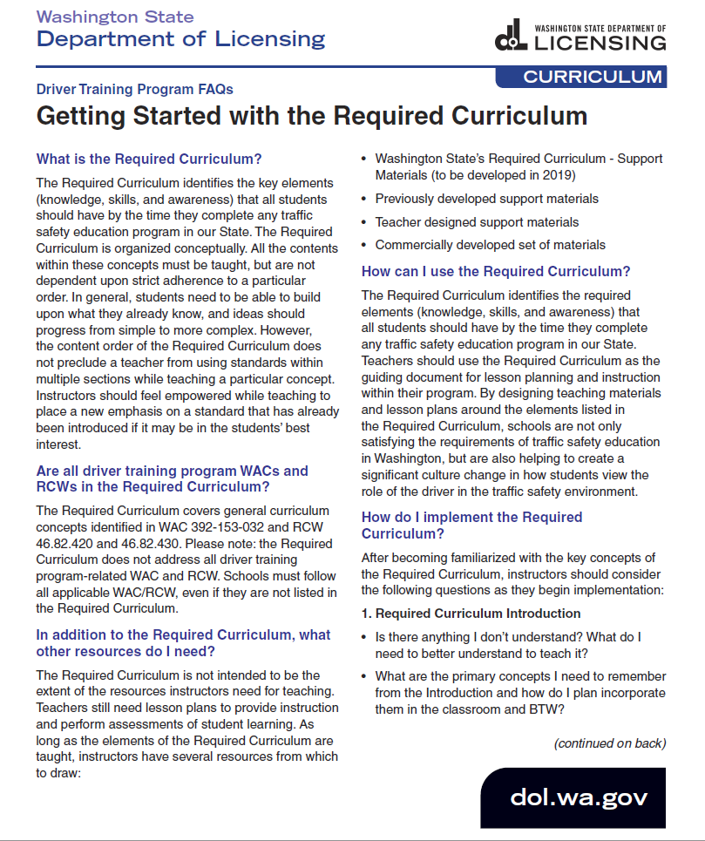
Curriculum
Information about the Required Curriculum is outlined in the 1-page FAQs sheet.
If you have any questions, please contact Patti Enbody at OSPI (patti.enbody@k12.wa.us) or Pam Meyers at DOL (pmeyers@dol.wa.gov).

Slide 31
The New Required Curriculum
The Department of Licensing and the Office of Superintendent of Public Instruction wish to thank:
Central Washington University
PDSA
WTSEA
Department of Health
Washington State Patrol
Washington Traffic Safety Commission
Curriculum Workgroup Members
Additional Layer of Review Members
Individual Subject Matter Experts
We greatly value your input and recognize your contribution!

Slide 32
The New Required Curriculum
By the end of this session…
Know what the Required Curriculum is… and is not
Explain the GDE Matrix and coaching
Identify your desired contribution to improving Traffic Safety
Understand what you should do next

Slide 33
The New Required Curriculum
Three Parts
Introduction
GDE Matrix & Coaching
Hazard Management
Future Developments
Curriculum Content (Standards)
Classroom
BTW
Self-Reflection
Glossary

Slide 34
The New Required Curriculum
Identify what the Required Curriculum is and is not
What it IS
What it IS NOT
A compilation of the concepts (knowledge, skills, awareness) that all students should have by the time they complete any driver training program in our State
The Driver’s Guide
An introduction to the need for culture change and a shift in how we view traffic safety (including our roles as instructors, students, and drivers)
A Panacea
A teaching and attitudinal approach that all teachers in our State should adopt to implement culture change through driver education
Support Materials
A living document that will be regularly updated
Set in Stone

Slide 35
The New Required Curriculum
What it IS
Culture Change:
Privilege vs. Right
“Safe” is continually able to adapt to any situation vs. being able to correctly perform a maneuver
“Responsible driving” (active) vs. “Safe Driver” (innate)
A compilation of the concepts (knowledge, skills, awareness) that all students should have by the time they complete any driver training program in our State
An introduction to the need for culture change and a shift in how we view traffic safety (including our roles as instructors, students, and drivers)
A teaching and attitudinal approach that all teachers in our State must adopt to implement culture change through driver education
A living document that will be regularly updated

Slide 36
Culture Change
We’ve been teaching students how to drive
Result: “Safe Driver”
There is a difference between thinking you are a “safe driver” (innate) and being someone who is practicing responsible driving (active)
Notes:
Vaccinated = Safe “I am a vaccinated person”
How often to you think about contracting polio or scarlet fever? Do you need to worry about it?
What about getting behind the wheel. Is there a danger in believing you are a “safe” driver because you passed your test and got your license?

Slide 37
The New Required Curriculum
What it IS
Shift in View:
Training does not automatically create “safe drivers”. Through training, we are creating drivers who start with minimum competency and begin actively practice aware and responsive driving.
A compilation of the concepts (knowledge, skills, awareness) that all students should have by the time they complete any driver training program in our State
An introduction to the need for culture change and a shift in how we view traffic safety (including our roles as instructors, students, and drivers)
A teaching and attitudinal approach that all teachers in our State should adopt to implement culture change through driver education
A living document that will be regularly updated

Slide 38
The New Required Curriculum
What it IS
Our role as instructors is shifting toward mentorship and coaching
Our role as students is taking a more active, self-reflective role to become equipped to self-evaluate and learn from our mistakes
Our role as drivers is to understand how we contribute to the driving environment
A compilation of the concepts (knowledge, skills, awareness) that all students should have by the time they complete any driver training program in our State
An introduction to the need for culture change and a shift in how we view traffic safety (including our roles as instructors, students, and drivers)
A teaching and attitudinal approach that all teachers in our State should adopt to implement culture change through driver education
A living document that will be regularly updated

Slide 39
The New Required Curriculum
What it IS
A teaching and attitudinal approach
The GDE Matrix provides a framework for teachers to take what we’ve been doing and add another layer of learning by prompting students to move from unaware to aware of their own attitudes, values, motivation, and self-perception. This is what influences driver decisions and awareness.
A compilation of the concepts (knowledge, skills, awareness) that all students should have by the time they complete any driver training program in our State
An introduction to the need for culture change and a shift in how we view traffic safety (including our roles as instructors, students, and drivers)
A teaching and attitudinal approach that all teachers in our State should adopt to implement culture change through driver education
A living document that will be regularly updated

Slide 40
The GDE Matrix
GDE (Goals for Driver Education) Matrix
What is it? A map depicting a hierarchy of skills, including driver attitudes and beliefs, that influence decision making.
Why is it part of the new Required Curriculum? Because we recognize that until drivers become aware of their attitudes and beliefs, they will continue to make unconscious decisions that override competency training in vehicle handling.
What is the objective? With coaching, to help students develop self-awareness of strengths and weaknesses, which is an essential part of self-evaluation.

Slide 41
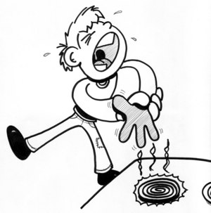
The GDE Matrix
 | Knowledge and Skills | Risk Factors to be Aware of | Self-Evaluation
The Person (attitudes and behaviors) | We defend how we see ourselves, even while driving. | Type A personalities stress when running late. | How can I calm myself down when running late?
The Journey (trip-related factors) | Attitudes effect a driver’s decisions. | Being angry can affect how closely we follow other drivers. | Do I have the type of attitude right now that I’d like drivers around me to have?
The Road (traffic situations) | Drivers have a way of interacting in traffic that they become used to. | Driving styles of making last-minute changes can surprise other drivers. | Does my driving style require others to respond by slowing, swerving, or stopping?
The Vehicle (maneuvers) | The driver must be able to parallel park. | Parallel parking requires a driver to reverse in a confined space. | Can I determine what space I need to successfully maneuver my vehicle?

Slide 42
The GDE Matrix
 | Knowledge and Skills | Risk Factors to be Aware of | Self-Evaluation
The Person (attitudes and behaviors) | We defend our self image, even while driving. | Type A personalities stress when running late. | How can I calm myself down when running late?
The Journey (trip-related factors) | Rain or snow may affect how long it takes to get somewhere. | Poor driving conditions can significantly increase stress and driving time. | Do I prevent stress by planning alternate routes and leaving plenty of time for my trip?
The Road (traffic situations) | Drivers have a way of interacting in traffic that they become used to. | Driving styles of making last-minute changes can surprise other drivers. | Does my driving style require others to respond by slowing, swerving, or stopping?
The Vehicle (maneuvers) | The driver must be able to parallel park. | Parallel parking requires a driver to reverse in a confined space. | Can I determine what space I need to successfully maneuver my vehicle?

Slide 43
The GDE Matrix
 | Knowledge and Skills | Risk Factors to be Aware of | Self-Evaluation
The Person (attitudes and behaviors) | We defend our self image, even while driving. | Type A personalities stress when running late. | How can I calm myself down when running late?
The Journey (trip-related factors) | Rain or snow may affect how long it takes to get somewhere. | Poor driving conditions can significantly increase stress and driving time. | Do I prevent added stress by planning alternate routes and leaving plenty of time for my trip?
The Road (traffic situations) | Drivers have a way of interacting in traffic that they become used to. | Driving styles of making last-minute changes can surprise other drivers. | Does my driving style require others to respond by slowing, swerving, or stopping?
The Vehicle (maneuvers) | The driver must be able to parallel park. | Parallel parking requires a driver to reverse in a confined space. | Can I determine what space I need to successfully maneuver my vehicle?
Aware Unaware

Slide 44
Self-Reflection and Self-Evaluation
Self-Reflection
Move from unaware to aware of values, attitudes, motives, which affect behaviors
“What you are unaware of controls you.”
Self-Evaluation
Practice responsible driving by actively following the 3S Principles:
Speed management
Space management
Situational awareness

Slide 45
Instruction & Coaching
Instructing (teaching)
Telling the learner what they need to know (knowledge) and what they need to do (maneuvers)
Teacher in the active role
Coaching (learning)
Through effective questioning, learner becomes their own teacher
Learner in the active role
Increases responsibility and awareness of learner
“Look in the mirror.” | “What’s happening behind you?”
“Leave more space.” | “How is your view when you hang back a bit?”
“Slow down.” | “How appropriate do you think your speed is?”
Coaching scenarios: http://www.alles-fuehrerschein.at/HERMES/documentation/HERMES%20scenarios%20english.pdf

Slide 46
The New Required Curriculum
Focused on student outcomes
Full spectrum of driver training
Techniques for consistent self-assessment and life-long learning
Deeper-learning questions and coaching
Acknowledges complex problem-solving and decision-making behaviors in an infinite array of contextual situations
Draws from training approaches being used in countries with the most successful results
Notes:
It focuses on student outcomes, which are the desired outcomes for moving us toward Target Zero
It addresses the full spectrum of driver training, from basic how-to driving instruction to a more robust focus on how the drivers’ conscious and unconscious values and attitudes affect driving behaviors.
It provides students with techniques for consistent self-assessment and life-long learning
It support teachers in asking deeper-learning questions and coaching students
It acknowledges that driving is a series of complex problem-solving and decision-making behaviors in an infinite array of contextual situations. It highlights that effective driver training cannot be taught using checklists.
It draws from training approaches being used in countries with the most successful results.

Slide 47
Identify Your Desired Contribution
Full-Spectrum Training
Driving
Driver
Rules
Operating Skills
Maneuvers
Situational Awareness
Risk Management
Hazard Management
Context Recognition
Self-Awareness
Self-Evaluation
Mistake Management
Contextual Decision-making
Developing drivers who
practice responsible driving
because they are both capable and compelled
Notes:
Goal:
Developing a driver who practices responsible driving because they are capable and compelled.
If drivers aren’t compelled, if there is a lack of motivation for practicing responsible driving, then no level of skills in mastering traffic situations or vehicle handling is high enough to compensate for this lack of aware and responsible driving.
It’s as if we’ve been concentrating on driving training, but we haven’t fully covered everything for driver training.

Slide 48
What is ahead?
Support materials coming next year.
Meanwhile…
As you review the Required Curriculum, you will probably notice that you are already teaching most of these concepts. If a concept is new to you, make note of where in your lesson plans you might include it. – We know these concepts are fundamental and important. How we go about implementing them is something we are all figuring out, and we know that is going to take some time and experimentation.
Explore… Innovate… Report Back…
(pmeyers@dol.wa.gov)
Notes:
Goal:
Developing a driver who practices responsible driving because they are capable and compelled.
If drivers aren’t compelled, if there is a lack of motivation for practicing responsible driving, then no level of skills in mastering traffic situations or vehicle handling is high enough to compensate for this lack of aware and responsible driving.
It’s as if we’ve been concentrating on driving training, but we haven’t fully covered everything for driver training.

Slide 49
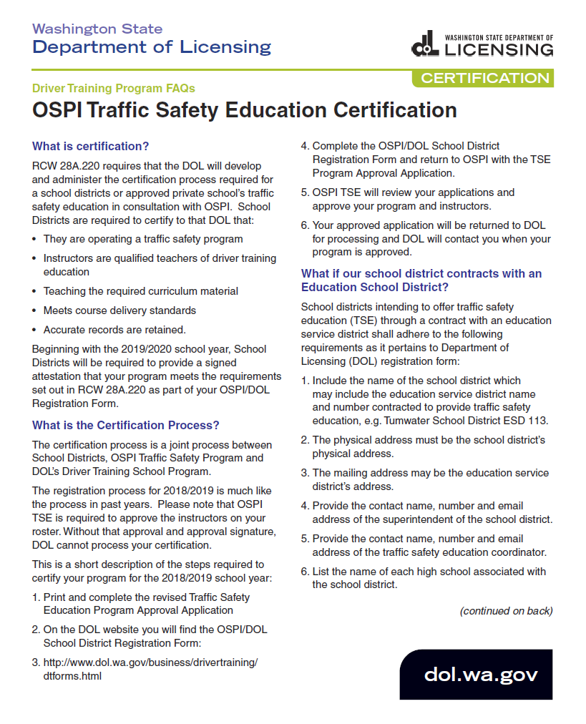
Certification
Information about the Certification Process is outlined in the 1-page FAQs sheet.
If you have any questions, please contact Patti Enbody at OSPI (patti.enbody@k12.wa.us) or Terri Staab at DOL (tstaab@dol.wa.gov).

Slide 50
OSPI TSE Program Approval and DOL Certification
Office of Superintendent of Public Instruction
Patti Enbody, Program Supervisor

Slide 51
Continuing Education
TSE endorsed and lifetime
40 clock hours every 5 years
Conditional
60 hours coursework – 12 must be TSE related – every 2 years

Slide 52
OSPI TSE Program Data
Updated every year
TSE Coordinator information
Personnel/instructors active
Vehicle data
Schools current
Notes:
OSPI’s online TSE program database must be updated every year. A bulletin is sent to school districts within the first two weeks of May when the database has been rolled over and ready for the new school year. It is important that the TSE Coordinator information is updated every year, as well as personnel information. Any changes in the vehicle(s) in use for TSE must be updated, also.

Slide 53
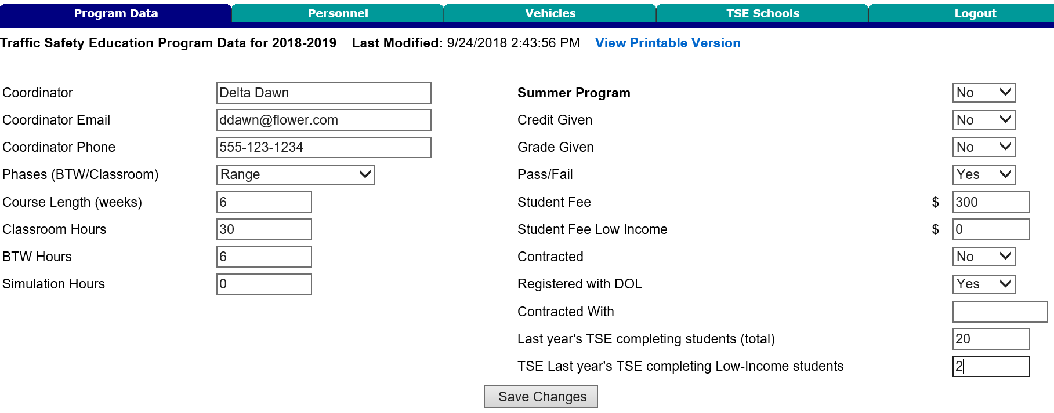
OSPI TSE Program Data

Slide 54
OSPI TSE Program Data
Personnel/Instructors – must match Registration
Notes:
List of active instructors. The instructors on this screen must have a current endorsement or conditional certificate. The application for program approval will not be approved if instructors are not current in Certification database.

Slide 55
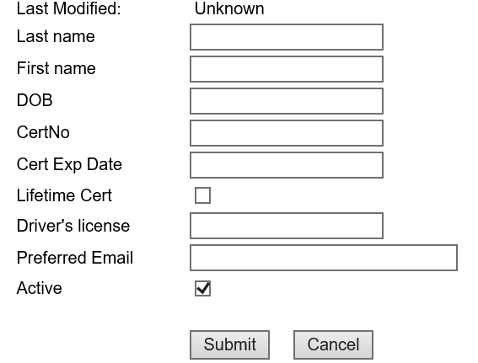
OSPI TSE Program Data
Notes:
If an instructor is no longer teaching, delete the instructor or uncheck the “Active” box. The person will have a different colored line on the personnel page and no schools associated with them.

Slide 56
OSPI TSE Application for Program Approval
Notes:
TSE Coordinator information should match information in OSPI TSE database

Slide 57
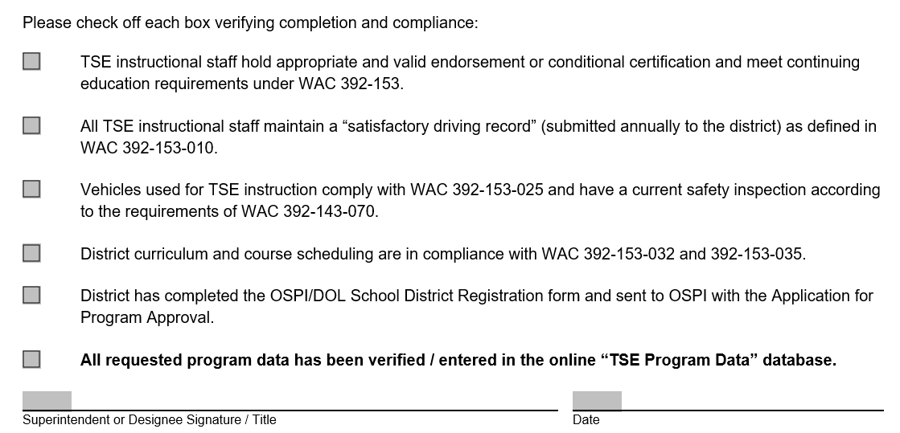
OSPI TSE Application for Program Approval
Notes:
Superintendent or designee is attesting that all information checked is current and valid.

Slide 58
OSPI School District/Instructor Registration
Send instructor information when add or delete from district
Instructors must match Personnel listed in OSPI TSE Program database
Notes:
If an instructor is on the registration form and not in the OSPI database, that instructor will not be approved on the Registration form.

Slide 59
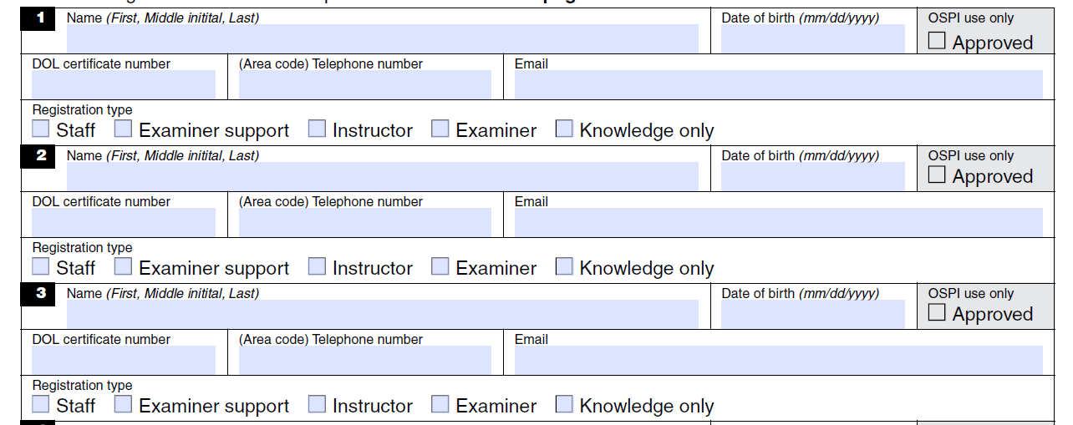
OSPI School District/Instructor Registration
Notes:
Instructors must be included on the personnel page for the district in OSPI’s TSE online database and must have a current TSE endorsement or conditional certificate.

Slide 60
Call or email if you have questions or need assistance:
Patti Enbody: (360) 725-6122
patti.enbody@k12.wa.us

Slide 61
Certification Process
❶ Complete TSE Program Approval Application (OSPI)
❷ Complete School District/Instructor Registration (DOL)

Slide 62
Certification Process
❸ Return both forms to OSPI.
❹ OSPI will review your applications to approve your program and instructors.
❺ Your OSPI approved application will be returned to DOL, and DOL will contact you when your program is certified.

Slide 63
What if I have more questions?
Contact DOL
Terri Staab at 360.664.6692 or tstaab@dol.wa.gov
Contact OSPI
Patti Enbody at (360) 725-6122
patti.enbody@k12.wa.us

Slide 64
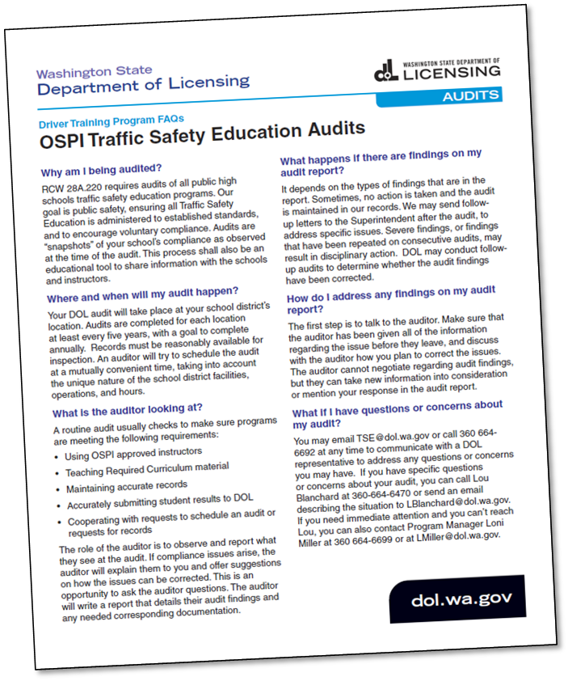
Auditing
Information about the Auditing Process is outlined in the 1-page FAQs sheet.
If you have any questions, please contact Patti Enbody at OSPI (patti.enbody@k12.wa.us) or the DTS program at DOL (tse@dol.wa.gov).

Slide 65
Auditing Process
❶ Schedule the date
A DOL auditor will contact the school district TSE Coordinator to schedule an on-site audit date.
September 1, 2018
Hello,
My name is Your Auditor. I have been assigned to conduct the Azeroth School District Driver Training School 2018 Annual Audit. I will be contacting you to schedule the on-site audit date.
Please fill out the Audit Records Request Form which is attached to this email. You will need to provide the completed form, the requested student records, and copies of the curriculum support materials during the audit.
Don’t hesitate to email me directly or call with any questions you may have!
Sincerely,
Your Auditor
Department of Licensing
DTS Auditor 3
360.664.1x2x
yourauditor@dol.wa.gov
NOTE: Beginning next Fall (September 2019), DOL will be auditing for the 5 items listed in the Audit 1-page Information Sheet. OSPI and DOL are currently in the rule making process. How the curriculum will be audited and if additional items will be added will be determined. Program audits will start no sooner than September 2019 (Exam audits will continue as regularly scheduled.)

Slide 66
Auditing Process
❷ Audit Items Request
This is the Audit Information Request Form with a sample list of documents and information being requested from the school district TSE Coordinator.
“Please gather these documents to provide during the audit.”

Slide 67
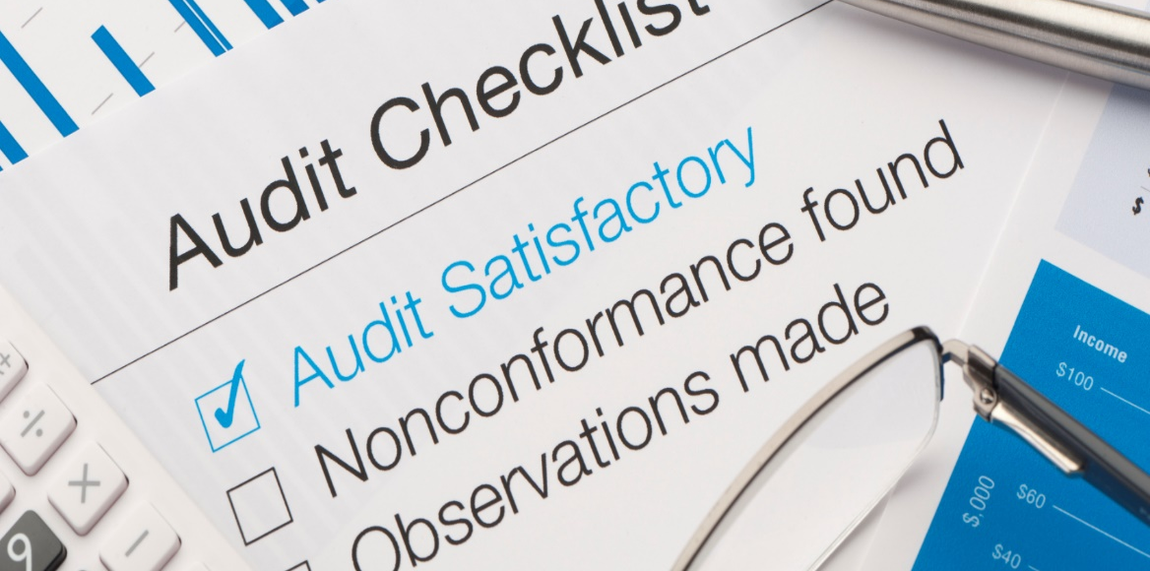
Auditing Process
❸ Conducting the Audit
DOL conducts the audit at the school district office. The auditor will provide a helpful information packet, review school and student records, discuss the program, and answer any questions.
❹ Audit Report
The Audit Report is written by the auditor and approved by DOL. A copy will then be provided to the school district TSE Coordinator and OSPI.

Slide 68
Auditing Process
❺ Audit Findings & Follow Up
At the conclusion of the audit, the auditor will review the findings with the TSE Coordinator. Processes that are being done correctly will be discussed, as well as any deficiencies and corrective action plans for the future.
This is a great opportunity to talk with your auditor about any questions you might have. Our staff is committed to helping you and your program succeed.

Slide 69
Compliance
How does my traffic safety education (TSE) program become non-compliant?
Using non-OSPI approved instructors
Not teaching Required Curriculum material
Accurate records are not maintained
Inaccurate submission of student results to DOL
Being uncooperative with request to schedule an audit or request for records
Notes:
We look to partner with you for a successful TSE program. To do that we need your help during audits. The following items will require you to work with us to correct:
Using non-OSPI approved instructors
Not teaching Required Curriculum material
Accurate records are not maintained
Inaccurate submission of student results to DOL
Being uncooperative with request to schedule an audit or request for records

Slide 70
Compliance
What happens to TSE programs that are non-compliant?
Education always starts at the audit
A letter of education may follow if a violation exists
Not teaching Required Curriculum material
Early compliance
Repeated violations may ultimately result in suspension from the portal
Notes:
DOL has a progressive discipline process that starts with a letter of education on your first violation. This educational letter will identify the areas that need improvement. The process is set up in stages to ensure early compliance with the law. If the same violation is repeated, then additional letters may be sent and may ultimately result in a suspension.

Slide 71
Compliance
Can DOL revoke my certification for TSE?
No, only OSPI can decertify a TSE program.
DOL can only suspend access to the portal. During a suspension period, a TSE program will not have the ability to enter permit waivers, course completions or test scores.
Notes:
This has nothing to do with teachers certification

Slide 72
Compliance
If my portal access has been suspended, how do I reinstate my access?
Provide a corrective action plan
Work with DOL to come up with an agreeable plan
Notes:
The letter of suspension will give you an opportunity to provide DOL with a corrective action plan. This plan would outline the steps that your program will take to ensure compliance. We will work with you to reach agreement on the action plan.

Slide 73
Compliance
Information about the Compliance Process is outlined in the 1-page FAQs sheet.
If you have any questions, please contact Patti Enbody at OSPI (patti.enbody@k12.wa.us) or the DTS program at DOL (tse@dol.wa.gov).

Slide 74
Drive Routes
Drive Routes
Lou Blanchard
DOL ME/Auditor 4
Washington State Department of Licensing

Slide 75
Could You Navigate This Route?

Slide 76
Agenda
Route Guidelines
Route Requirements
DOL Route Submission Process
Designing Your Route / Map Creation Tools
Notes:
Slide 2: Read Slide

Slide 77
Route Guidelines
Instructor Examiner Guidelines and Requirements (IEGR)
Section 6.1 – Drive Test Route
Notes:
Slide 3: The following slides are straight from IEGR Section 6.1

Slide 78
Route Guidelines
Schools should have at least two drive test routes. Second and more exams by an applicant will be performed on a different route. (if you only have two routes then the third test would be on the first route.)
Each route will contain the same required maneuvers.
Each route should be contained within a three- to five-mile radius from the business location or test start location and last no less than 15 minutes.
You may not use a drive test route of a Licensing Service Office(LSO).Drive the route without an applicant to make sure the maneuver locations you selected can safely provide the proper driving situations. Make sure the maneuvers are far enough apart to allow you time to score the maneuvers before giving the applicant the next instruction.
Notes:
Slide 4: Overview:
- 2 Routes minimum required
- All Maneuvers from those outlined in Chapter 6.2 (LATER SLIDES)
- 3-5 Miles, No less than 15 minutes, generally no more than 20 minutes
- Cannot use a test route from a LSO

Slide 79
Route Guidelines (Cont.)
Provide any updated copies of your drive test routes to the DTS program for approval prior to use. You may not use a drive test route that has not been approved by the DTS program first.
When submitting changes to the map, ensure it lists the school location, route number, and date of revision on each page. Route changes must be clearly noted with the location of each maneuver.
All routes are to start from your place of business unless you have been approved to start at another location. Clearly identify starting point on your map.
Testing routes may not be used for training of any kind.
Notes:
Slide 5: Overview:
- Routes sent to DTS Examiners inbox
- Header requirements
- Start from business location
- Cannot use testing routes for training.

Slide 80
Requirements
Instructor Examiner Guidelines and Requirements (IEGR)
Section 6.2 – Drive Test Route Requirements
Notes:
Slide 6: Read

Slide 81
Notes:
Slide 7: Easiest way to define requirements is to look at the Drive Route Review checklist

Slide 82
Route Requirements
Pre-Drive Items
(Less Drive with School Rep)
On Site
Maneuvers /
Traffic Control Devices
Notes:
Slide 8: The checklist is in essence separated by Pre-Drive and onsite items for review, which we will look at more closely on the next few slides.

Slide 83
Pre-Drive Items
Route driven by DOL representative – Provisional Routes, exception, not norm.
Contains map revision date – Revisions only.
Legible map with arrows and lines indicating path and direction – CRITICAL!
Map lists all maneuvers, lane changes, and start and end points – CRITICAL!
Route driven in vehicle with school representative – Not required.
Does route remain on public streets once leaving the start point
School name, location, route number on each page
Clearly legible map indicating path of travel -- So important, it’s listed twice!
Route starts from licensed location
Notes:
Slide 9: Review all

Slide 84
Route Requirements (IEGR p. 6-3)
Notes:
Slide 10 and 11: Briefly list all requirements. “We will look at a few of these maneuvers in more detail in coming slides”.

Slide 85
Route Requirements (IEGR p. 6-4)
Notes:
Slide 10 and 11: Briefly list all requirements. “We will look at a few of these maneuvers in more detail in coming slides”.

Slide 86
DOL Route Submission Process
Stakeholder emails routes to DTS Examiners inbox; Identify whether initial, revision, add route, construction etc. in subject line of message. Please send in Microsoft Word® if possible
Assigned to Auditor by Supervisor
Acknowledgement email sent with estimated date initial review date
Perform Initial Review:
Auditor begins filling out Drive Route Review Checklist (general data)
Ensure Map clearly shows direction of travel / streets are clearly marked
Validate map contains all items on Drive Route Review Checklist and Update:
Ensure all required maneuvers are located on school’s submission, containing traffic control devices, etc..
Backing maneuver does not occur causing vehicle to back “into” a stop sign
Ensure Uncontrolled intersection are driven “Through”, not turned from/into
Notes:
Slide 12 and 13: Review process (read / talk to)

Slide 87
DOL Route Submission Process
Auditor Emails school with Initial Review results:
Send breakdown of any changes that need to occur in both written directions and map. Note: DOL will not schedule a physical drive until direction of travel and all streets on route are clearly marked
If slight modification is required (adjust arrows, slight written direction changes, etc.) and was submitted in Microsoft Word®, DOL may adjust and send back for acknowledgement / approval of the school
Auditor schedules and completes Physical Drive (once updates received if applicable)
Stakeholder makes any adjustments if needed, Auditor complete Drive Route Review Checklist, and obtains School Signature onsite
Receive final supervisor approval and signature – Send approved route to stakeholder.
Notes:
Slide 12 and 13: Review process (read / talk to)

Slide 88
Route Submission Things to Remember
Items that cause the most significant delay in route certification are the maps not clearly showing the direction of travel and all roads are not clearly labeled on the map.
Uncontrolled Intersections can be “3 Way Intersections”! They must be driven THROUGH (not turn into or from).
Having electronic versions of your route, makes it easier for schools to update quickly (due to construction, etc.). Remember, driving schools should have routes accessible to examiners, but not the applicants!
Backing maneuver into stop signs is not safe! Signage changes often (effects older route submissions) – Update when your route you notice these changes (small changes may not require DOL driving route). Plan for Alternates Backing!
Avoid Cul-de-sacs.
Notes:
Slide 14:
Delays in certification: READ
Uncontrolled Intersections: READ
Uncontrolled intersection: READ / Talk to
Electronic Versions: READ
Backing Maneuvers: READ – “Backing into a stop sign impedes the flow of traffic and can have an outcome ranging from a CP to a DP. I.E. vehs not being able to safely stop in the proper lane / going around the backing veh”.
Cul-de-sacs: Often can find children playing in them, avoid using whenever possible.
Speed limit signs: Schools must be cognizant of where posted signs are on your route. If a tester is driving in an area where the speed limit is knowingly not posted, it is not necessarily accurate to give them a “slow” on the skills exam if they are in compliance with RCW 46.61.400
Uncontrolled Intersection are becoming harder to find in some areas; we can approve without them after the DOL reviews the area to validate none are available (maintain 3-5 mile rule and 15-20 Min).

Slide 89
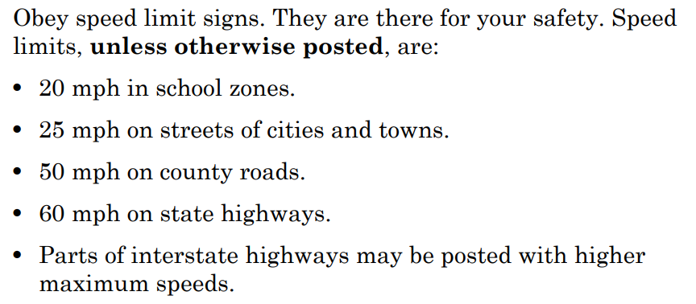
Route Submission Things to Remember
Be cognizant of posted speed limit sign locations on your route or lack there of!
Washington State Drivers Guide
Page 4-3 / RCW 46.61.400
Notes:
Slide 14:
Delays in certification: READ
Uncontrolled Intersections: READ
Uncontrolled intersection: READ / Talk to
Electronic Versions: READ
Backing Maneuvers: READ – “Backing into a stop sign impedes the flow of traffic and can have an outcome ranging from a CP to a DP. I.E. vehs not being able to safely stop in the proper lane / going around the backing veh”.
Cul-de-sacs: Often can find children playing in them, avoid using whenever possible.
Speed limit signs: Schools must be cognizant of where posted signs are on your route. If a tester is driving in an area where the speed limit is knowingly not posted, it is not necessarily accurate to give them a “slow” on the skills exam if they are in compliance with RCW 46.61.400
Uncontrolled Intersection are becoming harder to find in some areas; we can approve without them after the DOL reviews the area to validate none are available (maintain 3-5 mile rule and 15-20 Min).

Slide 90
Designing Your Route / Map Creation Tools
Instructor Examiner Guidelines and Requirements (IEGR)
Section 6.3 – Designing Your Route
Notes:
Slide 15: READ

Slide 91
Why Do We Care What The Maps Look Like???
“Ensure consistency of the drive test” (IEGR, p. 6-1)
Easier for Stakeholder employees to learn the route
Clear maps / written directions is a good business practice
Makes it faster for the certification of routes
Provides a “second set of eyes”
Notes:
NEED TO UPDATE – BRIAN/ROBERT:
Slide 16:
Ensure Consistency: READ. Give example of School sending in route and stating reason maneuvers weren’t marked on the map is because they were listed in the written directions. “Both the written portion and the maps must mirror one another to show this consistency”.
Employee Learning Routes: This applies specifically to larger schools that may have a higher turn over rate.
Good Business Practice: These items quite frankly could be admissible documents in a court of law. Presenting un-professional products may put into question in some minds on the professionalism of the entire business.
Faster Certification: As stated earlier, a much faster certification will occur if a school follows the guidelines presented today.
Provides a “second set of eyes” Second set of eyes (example of not finding the Milk in the fridge when it is right in front of you). Implications of driving outside of the approved route and implications of losing ability administer skills exam with DOL.

Slide 92
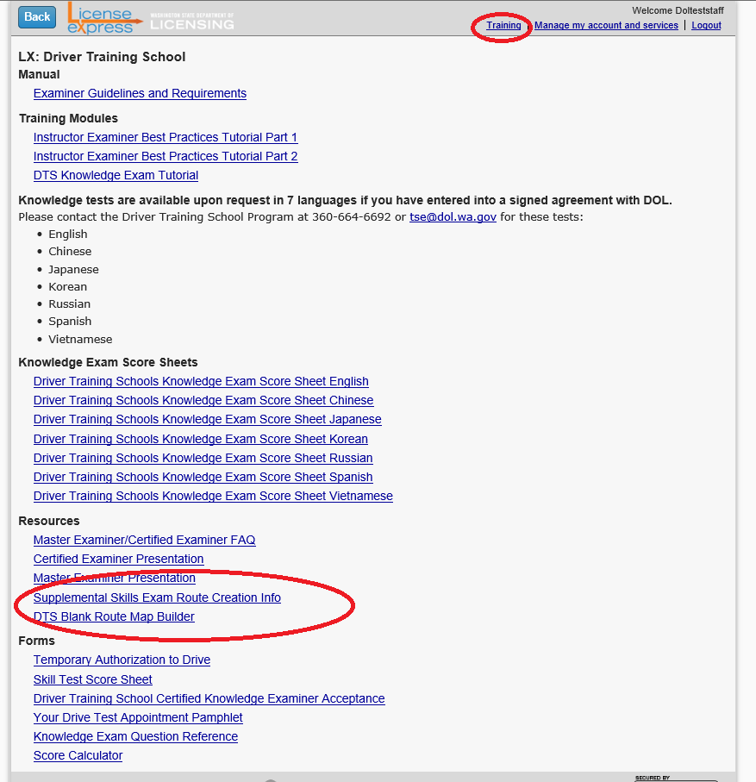
Route Creation tools are currently posted within the SAW Portal:

Slide 93
DTS Route Builder and Supplement
DOL Route Example
DTS Blank Route Map Builder
(Can also use Microsoft Publisher®)
Supplemental Skills Exam Route Creation Info

Slide 94
Route Comparisons
This by no means is the worst example of what the DOL has received; many submissions have roads with 2‐3 passes and can seem to blend into one another.
Staggering the arrows more closely, changing the color of the arrows, and labeling unmarked roads meets the requirement of the DTS Route approval checklist!

Slide 95
Bite Off More Than You Can Chew?
Questions? DTSExaminers@dol.wa.gov
Notes:
Slide 30: Any questions? If none, show next slide if they need assistance or have follow-up questions from what was presented.

Slide 96
Thank you!
Questions? Let’s talk…

